Slide 2
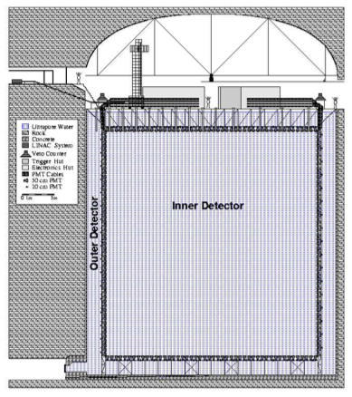
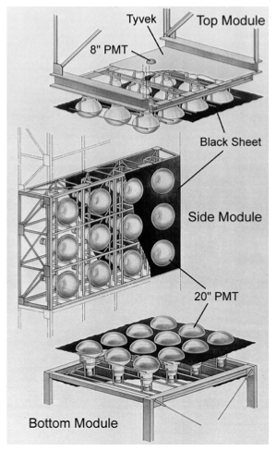

Slide 5
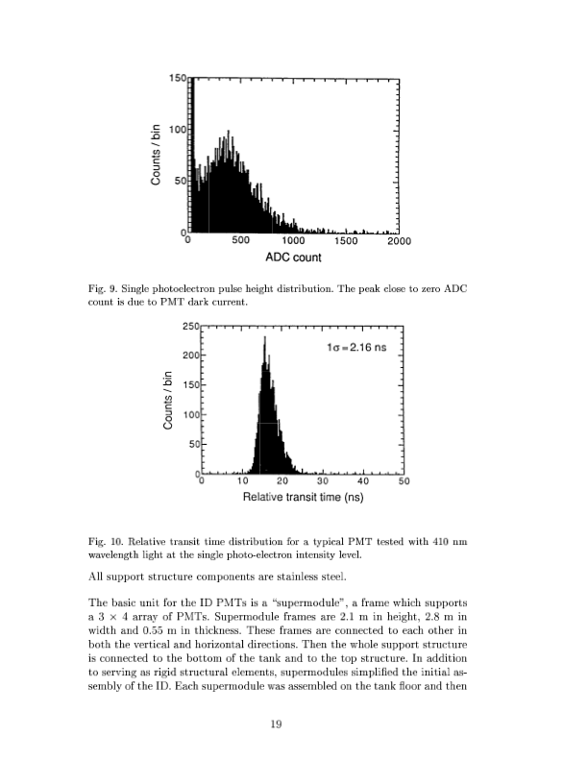

Slide 7
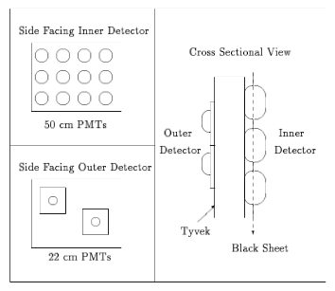

Slide 9
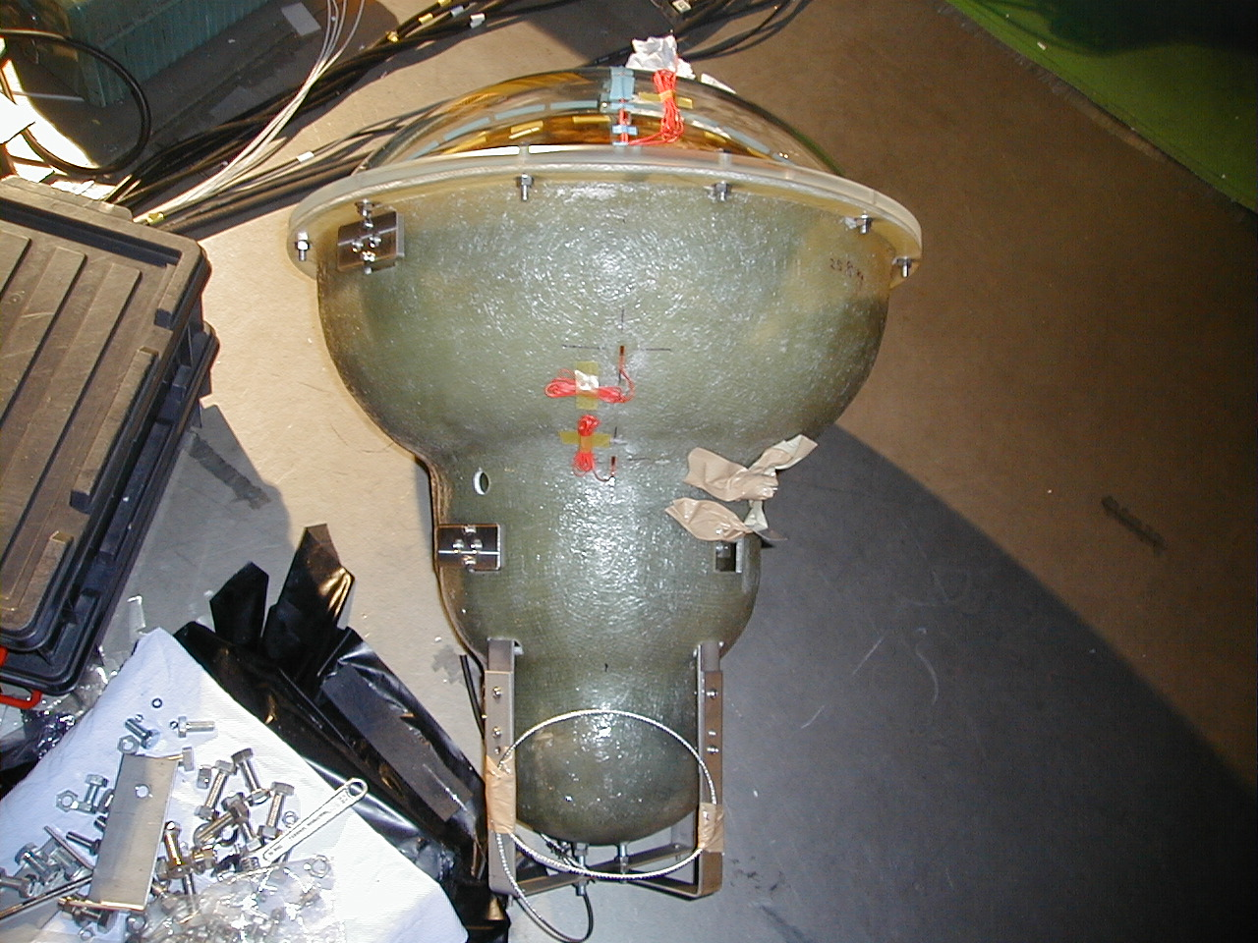
Acrylic
FRP

Slide 11


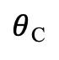
$$\frac{c}{n}t$$
$θ$_{C}
$$vt$$

Slide 14
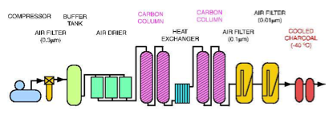

Slide 18
PMTs
Event builder
Merger
Software
trigger
QBEE
front-
end PC
switch
QBEE
Merger
Software
trigger
front-
end PC
QBEE
switch
switch
switch
switch
Organizer
Merger
Software
trigger
QBEE
front-
end PC
QBEE
Merger
Software
trigger
Ethernet
Disk
13,000
PMTs
550
QBEEs
20
Front-end PCs
10
Merger PCs

